Slide 1



ChatAlone Offline Anonymous Messaging Application for Enhanced Privacy and Open Communication
Student: Lin Run Yu
Supervisor: Dr Owen Noel Newton Fernando
Examiner: Prof Cham Tat Jen
Project ID: SCSE23-1152

Slide 2
Agenda
1
Introduction
2
Research
3
Features
4
Demonstration
5
Conclusion

Slide 3
1
Introduction

Slide 4



What is ChatAlone?
Anonymous chat application
Uses Bluetooth to communicate
Available on Android and iOS

Slide 5

ChatAlone Development
Used Flutter to develop ChatAlone
Allows developers to build applications for Android and iOS from single codebase
Provides vast library of customizable widgets and packages

Slide 6
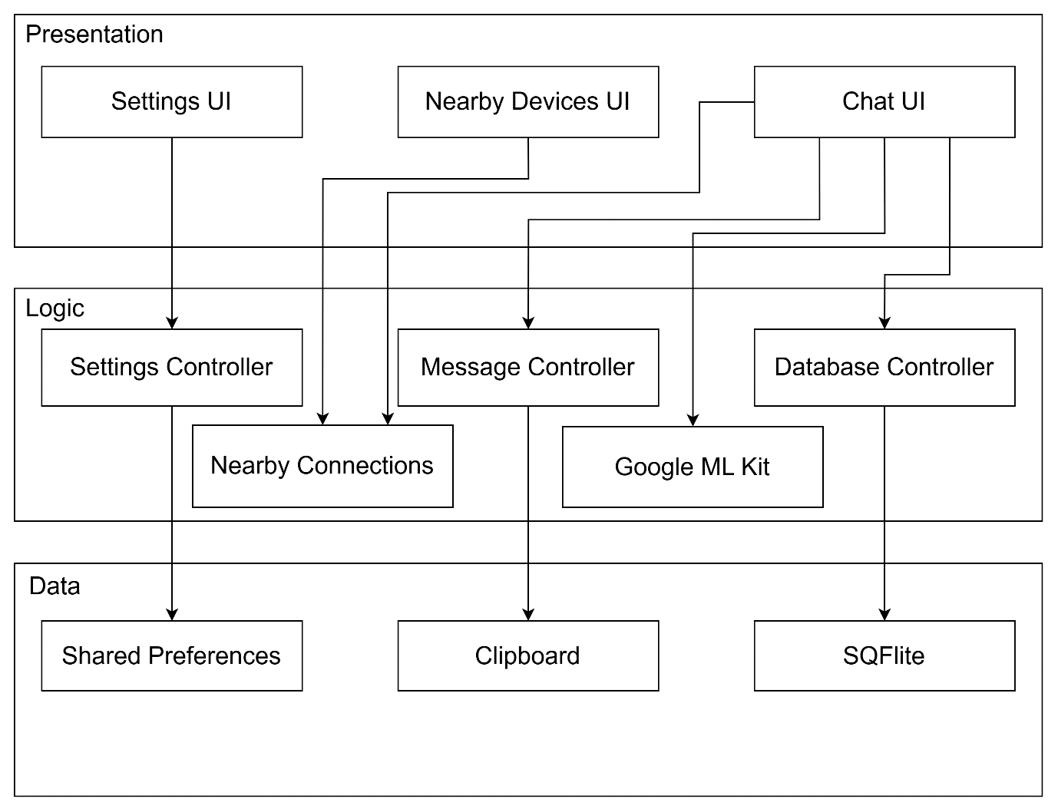
ChatAlone Architecture

Slide 7
2
Research

Slide 8
Popular Chat Applications Problems
Non-Anonymous
Online
Cloud-Based
Need reveal email or phone number to use
Utilises Wi-Fi or cellular
Data stored on remote servers

Slide 9
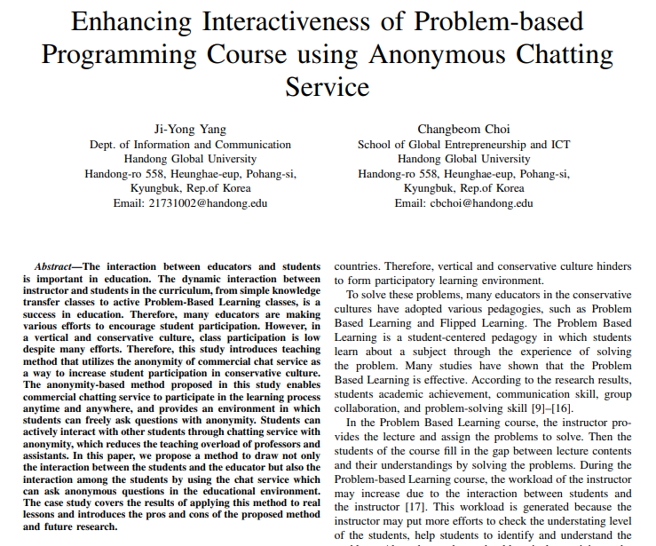
Non-Anonymous
Online
Cloud-Based
New teaching method using anonymous chat service
Discovered that student participation increased
People are less expressive when not anonymous

Slide 10


Non-Anonymous
Online
Cloud-Based
Bluetooth
Bluetooth attack range is much lower than Wi-Fi/Cellular attack range
10m
Wi-Fi
50m
Cellular
>1km

Slide 11


Non-Anonymous
Online
Cloud-Based
Remote servers are popular for hackers to attack as they contain large quantities of data

Slide 12



Existing Solutions
Briar
Bridgefy
FireChat

Slide 13



Existing Solutions Limitations
Only supports English as interface language
Lack multiplayer games
No restrictions on content sent

Slide 14
Existing Solutions Limitations
Briar, Bridgefy and FireChat only supports English as their interface language
In multilingual country like Singapore, relying solely on English excludes many Singaporeans
Hinder accessibility in multilingual societies

Slide 15
Existing Solutions Limitations
Bridgefy, Briar, and FireChat lack games
Research has shown games enhance social interaction and emotional connection
Limits engagement and makes conversations feel static

Slide 16
Existing Solutions Limitations
No restrictions on Briar, Bridgefy and FireChat on what content cannot be sent
Research has shown anonymity leads to increase aggression in online environments
Users are more likely to send offensive content to others

Slide 17
ChatAlone Requirements
Need not reveal email or phone number to use
Uses Bluetooth peer-to-peer connection
Stores data locally
Supports more languages besides English
Has multiplayer games
Has offensive content filter that detects nudity and profanity

Slide 18
3
Features

Slide 19
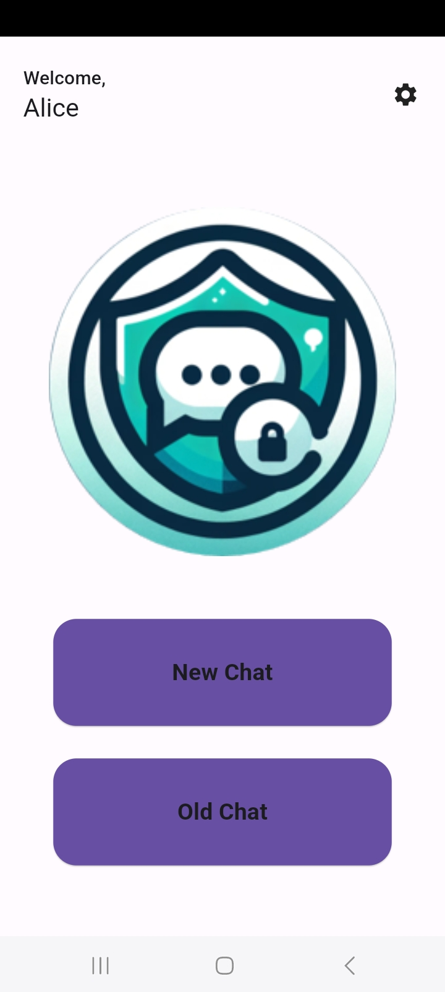

Theme
Light Mode
Dark Mode

Slide 20
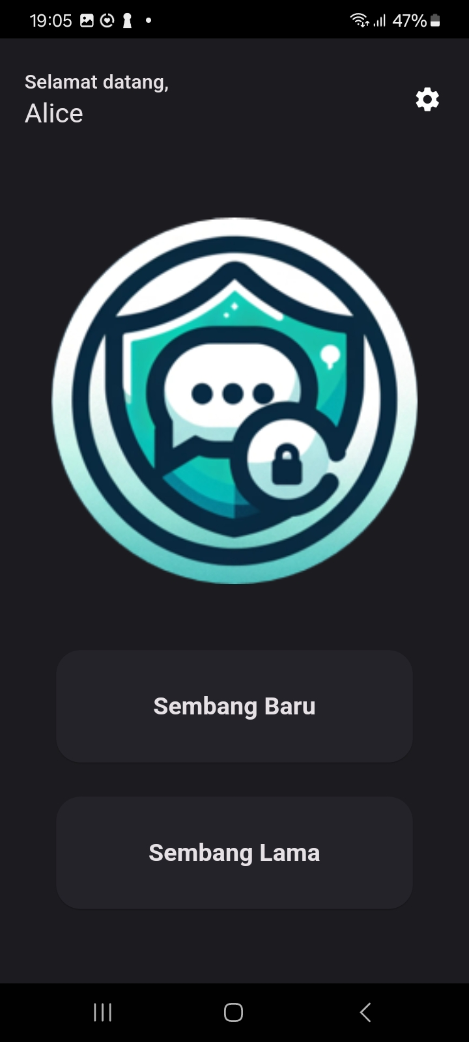


Multi-language Support
English
Malay
Chinese
Tamil

Slide 21
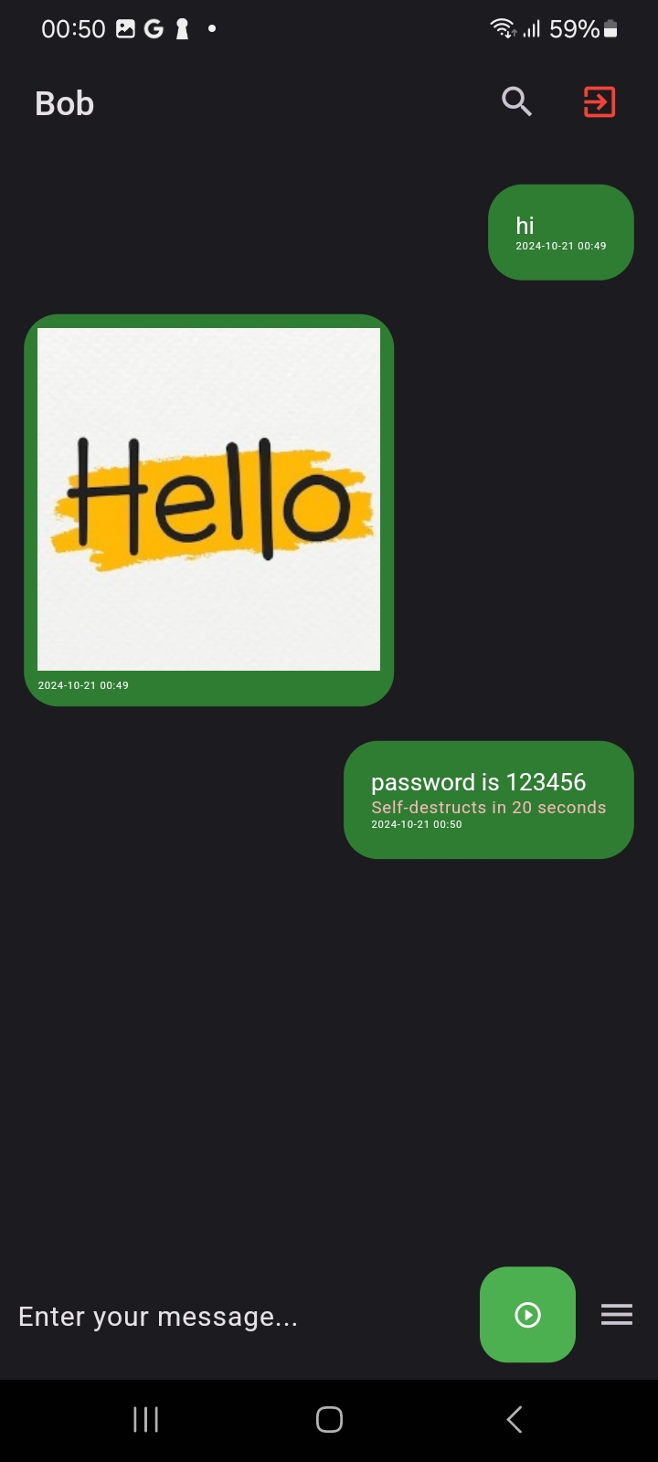
Chat Types
Person Chat
Chat between 2 persons
Can send text messages and images
Can play multiplayer games
Group Chat
Chat between 3 or more persons
Hosted by 1 person
Can send text messages and images

Slide 22
Text Messages
Copy message to clipboard
Edit previously sent messages
Delete previously sent messages
Reply to specific received messages
React to received messages using emojis
Send messages that self-destruct after set time

Slide 23
Images
User selects image
Application checks whether image is less than 20KB
Application scans for nudity
Application scans for profanity
Application sends image as string
Application base-64 encode image into string

Slide 24
Offensive Content Filter
Profanity in text messages
Used profanity_filter to detect profanity
Profanity in images
Used google_mlkit_text_recognition to recognize texts, then used profanity_filter to detect profanity
Nudity in images
Used flutter_nude_detector and TensorFlow Lite model to detect nudity

Slide 25
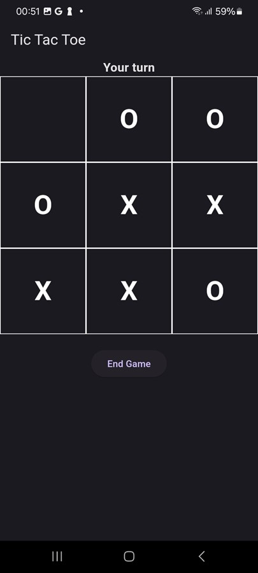
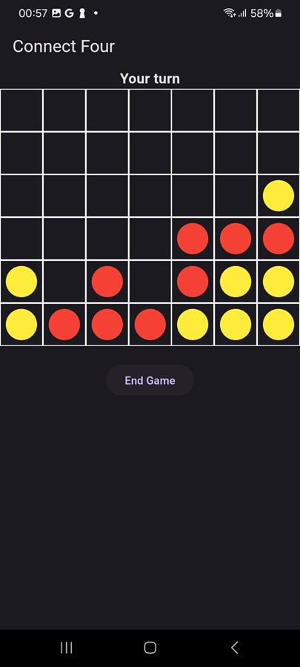
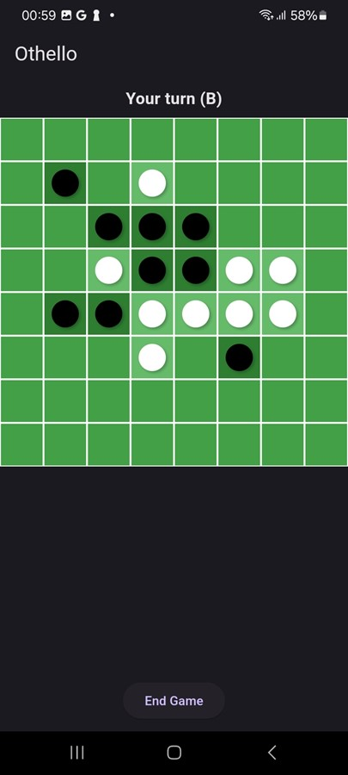
Multiplayer Games
Tic Tac Toe
Connect Four
Othello

Slide 26
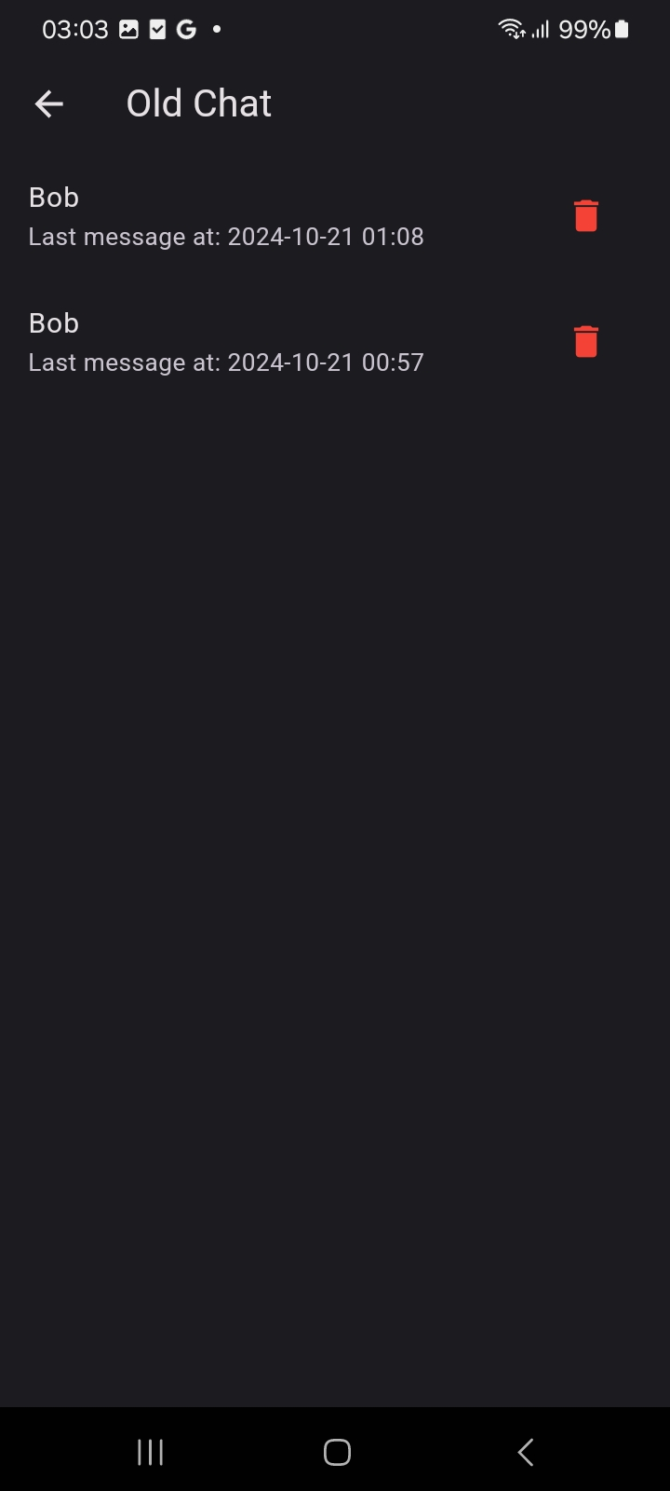
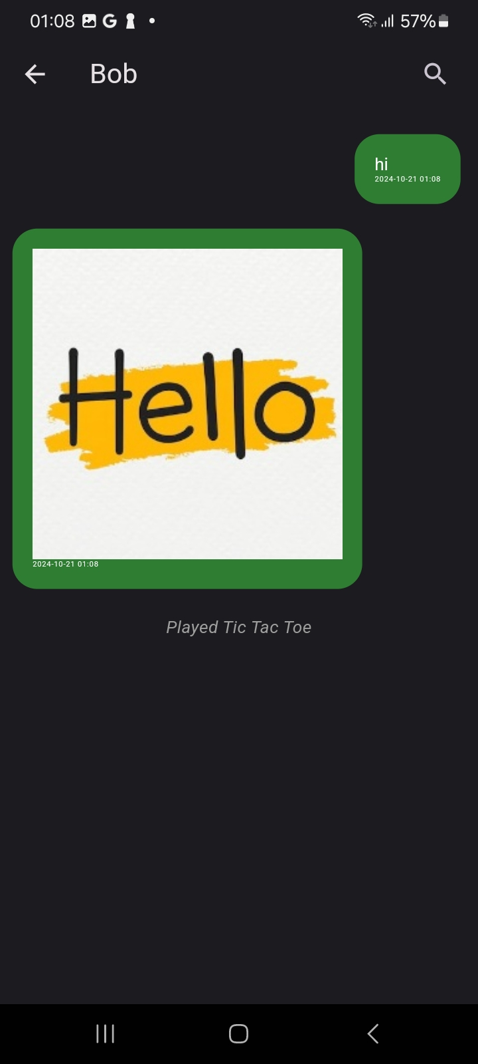
View Old Chats
Person or group chat session is stored locally on users’ devices after ending
Uses Flutter’s sqflite to store chat data
Stored in First-In Last-Out stack structure with newest session displayed on top

Slide 27
4
Demonstration

Slide 28
5
Conclusion

Slide 29


Popular Chat Applications vs ChatAlone
 | Popular Chat Applications | ChatAlone
Does not collect personal information
Bluetooth connection only
Local storage only

Slide 30
Existing Bluetooth Chat Applications vs ChatAlone
 | Existing Bluetooth Chat Applications | ChatAlone
Multi-language
Multiplayer Games
Offensive Content Filter

Slide 31
Future Works
Transfer files larger than 20KB
More games such as Chess and Weiqi
Detect non-nude pornographic content

Slide 32
Thank You

